Slide 1
Federal Travel GSA Scheduling
541-Operational Research Deteministic Model Project Presentation
Sahithi Lakamana
Srashti Agrawal
Nikita Bhole

Slide 2
Problem Statement
Defense Contract Management Command has 15000 employees in 216 cities and wanted his employees to attend professional development training at different locations in USA.
There is a costs associated with this training constitute a substantial portion of the DCMC's budget.
They are looking for 25 percent budget reduction while maintaining the same training requirement.
They want a method for evaluating travel costs and determining the least expensive conference site from over 216 US cities.

Slide 3
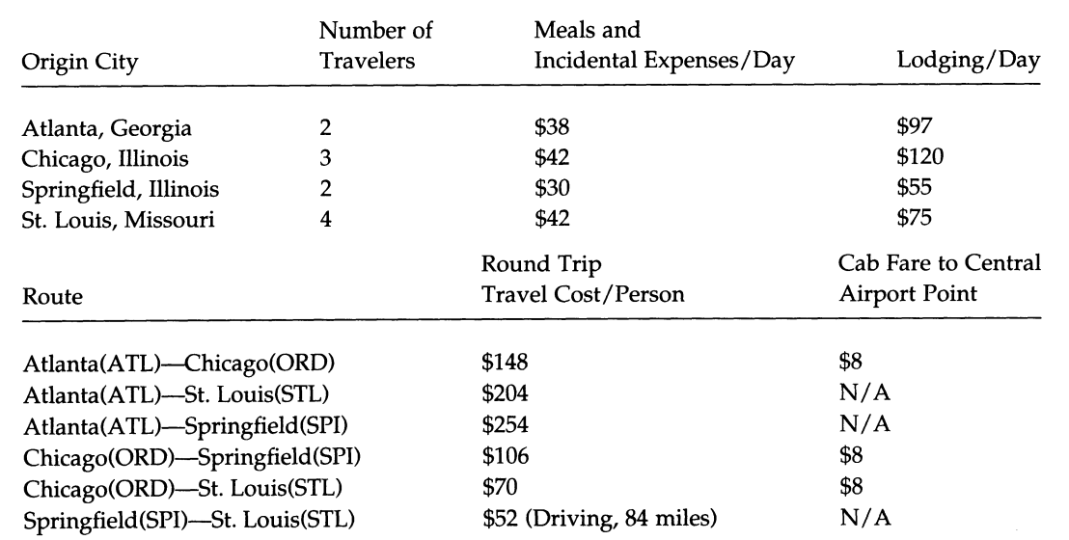
Data
To compute the lowest cost location for training:
We consider 4 cities and 11 employees to work on project.
Consider Meal cost and Lodging cost
Travel Cost per city
Cab fare

Slide 4
Language used (R programming)
Why R-
R is a programming language and free software environment for statistical computing. The R language is widely used among statisticians and data miners for developing statistical software and data analysis and it is easy to learn.

Slide 5
Methods and Methodologies Applied
Shortest path Algorithm
The shortest path problem is the problem of finding a path between two vertices (or nodes) in a network such that the sum of the weights of its constituent edges is minimized.
Dijkstra Algorithm
Bellman ford Algorithm
Johnson Algorithm
Floyd Warshall Algorithm

Slide 6
Dijkstra’s Methodology
Dijkstra’s algorithm finds a shortest path tree from a single source node, by building a set of nodes that have minimum distance from the source.
Path can be directed or undirected.
Can accept non-negative weights.

Slide 7
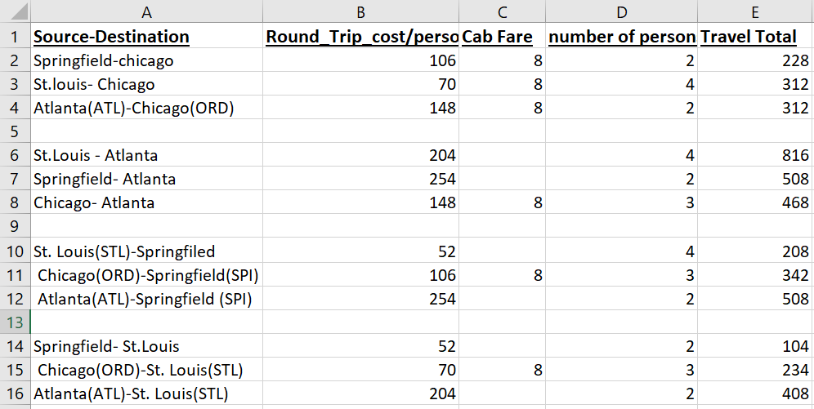
Data considered from Dijkstra’s Algorithm

Slide 8
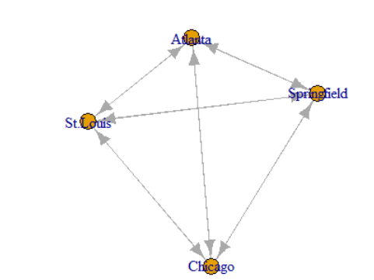
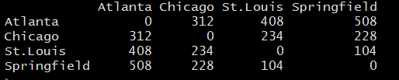
Output and Graph Acquired from Dijkstra’s Algorithm

Slide 9
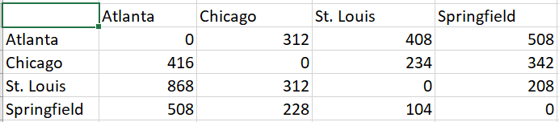
Comparison With Input and Output

Slide 10
Bellman-Ford Algorithm
The Bellman–Ford algorithm is an algorithm- computes shortest path from a single source vertex to all of the other vertices in a weighted graph.
It is slower than Dijkstra's algorithm for the same problem, but more versatile, as it is capable of handling graphs in which some of the edge weights are negative numbers.
Can accept weighted graphs.

Slide 11
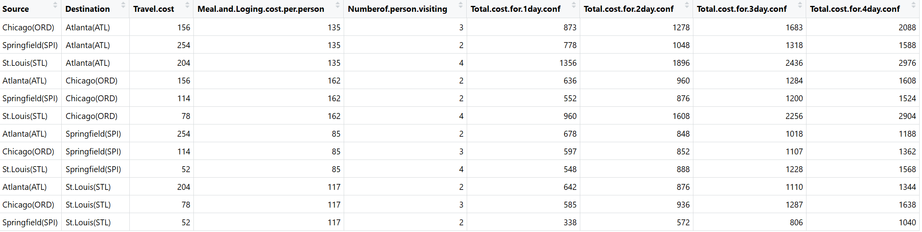
Input for Bellman-Ford Algorithm

Slide 12
Output For Bellman-Ford Algorithm

Slide 13
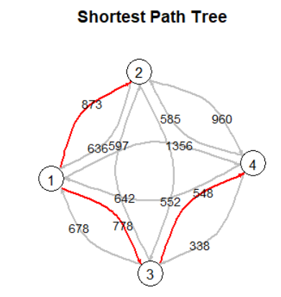
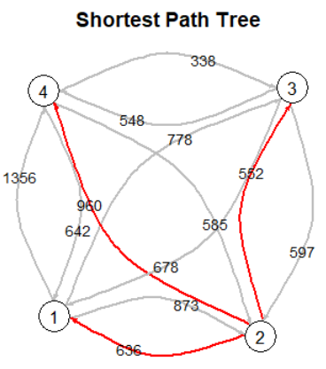
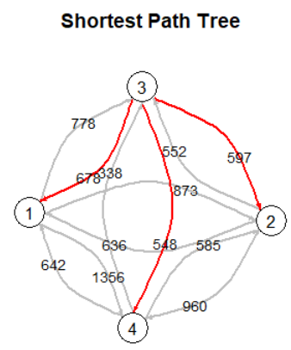
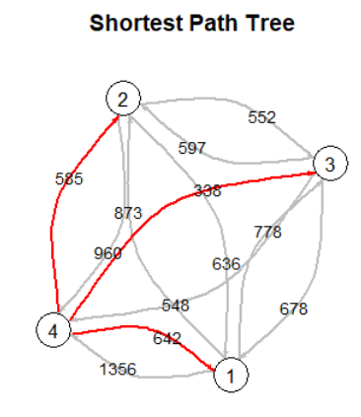
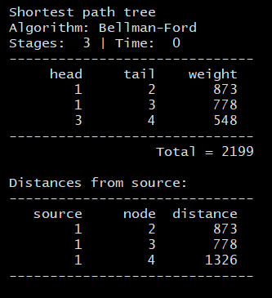
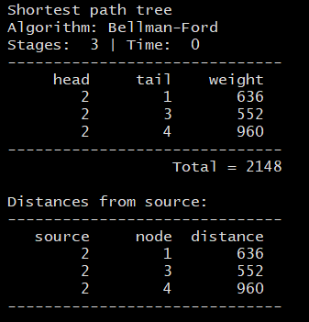
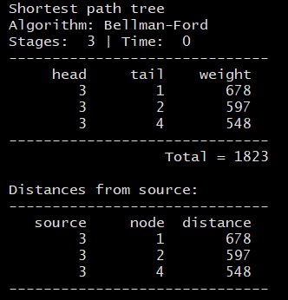
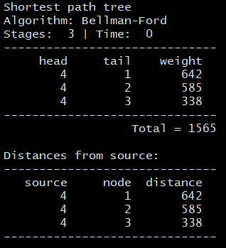
Atlanta
Chicago
Springfield
St. Louis

Slide 14
Conclusion
The minimum total cost where the conference can be held is St. Louis.
The minimum cost is $1565 (which includes meal, lodging, travelling and cab fare for 1 day) when all persons are travelling to St. Louis from all other locations.

Slide 15
Total budget of training for each cities.

Slide 16
Comparisons of Running Time
METHOD | TIME (in seconds)
Dijkstra’s Algorithm | 0.04
Bellman-Ford | 0.09

Slide 17
Extra Efforts
Johnson’s Algorithm
Floyd-Warshall Algorithm
Sensitivity Analysis

Slide 18
Johnson’s Algorithm
Johnson's algorithm is a way to find the shortest paths between all pairs of vertices in a sparse, edge-weighted, directed graph.
Johnson’s algorithm uses both Dijkstra and Bellman-Ford as subroutines.

Slide 19
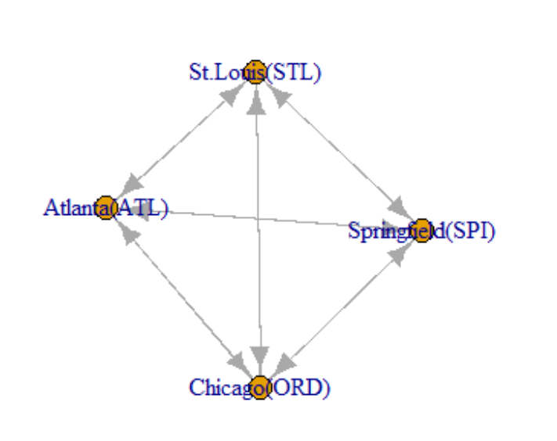
Graph generated by Johnson’s Algorithm

Slide 20
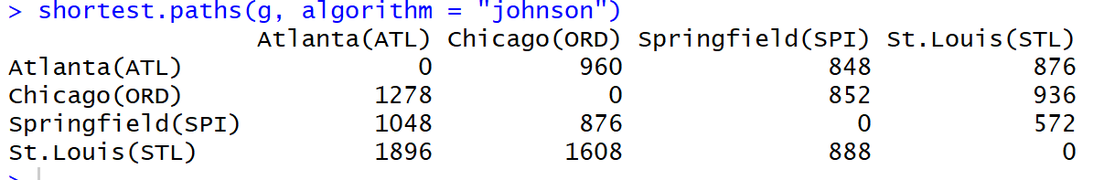
Output from Johnson’s Algorithm for 2 days training.

Slide 21
Floyd-Warshall Algorithm
Floyd–Warshall algorithm is an algorithm for finding shortest paths in a weighted graph with positive or negative edge weights (but with no negative cycles).
A single execution of the algorithm will find the lengths (summed weights) of shortest paths between all pairs of vertices.

Slide 22
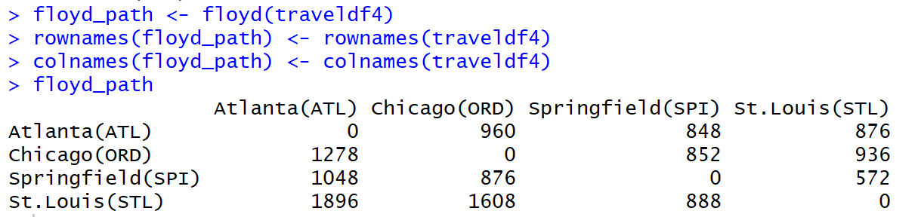
Output from Floyd Warshall Algorithm for 2 days training.

Slide 23
Comparisons of Running Time
Methods | TIME (in seconds)
Dijkstra’s Algorithm | 0.04
Bellman-Ford | 0.09
Johnson’s Algorithm | 0.05
Floyd- Warshall | 0.12

Slide 24
Sensitivity Analysis
The technique used to determine how independent variable values will impact a particular dependent variable under a given set ofassumptions is defined as sensitive analysis.
Importance
It helps in identifying the key variables that are major influence in the cost and benefits of the project.

Slide 25
Sensitivity approach to our problem
In our data as all nodes are interconnected (i.e. we can fly from every location to other) it is hard to make the difference in output.
Breaking the link between Atlanta to Chicago.
Considered the travel cost (between cities) only
Applied on Dijkstra’s And Johnson’s Algorithm

Slide 26
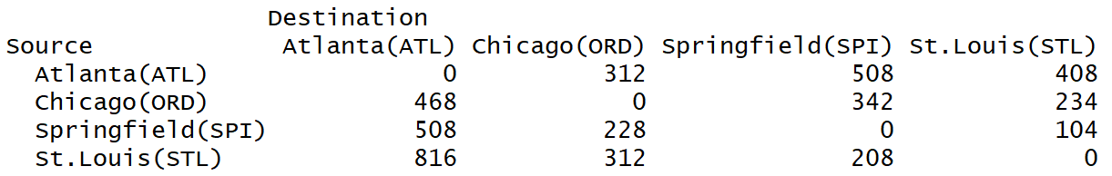
Original travel cost with number of person visiting to particular city for training

Slide 27
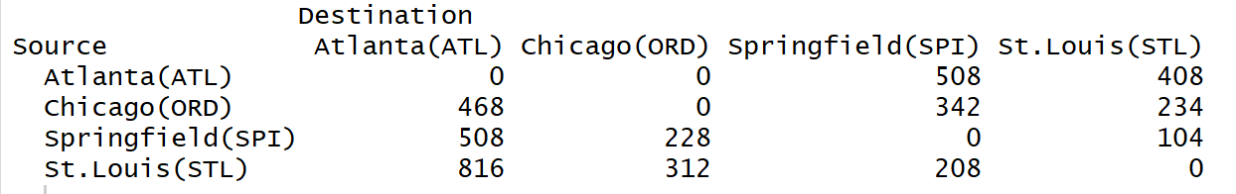
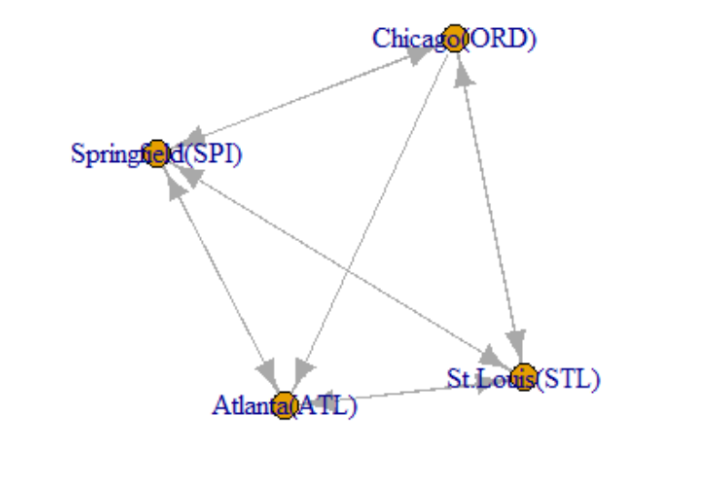
Suppose no connectivity from Atlanta to chicago

Slide 28
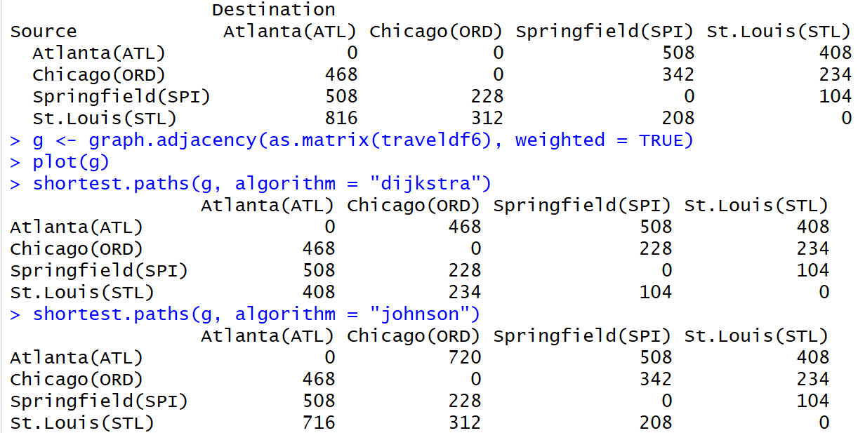
Output comparison of Dijkstra Algorithm and Johnson’s algorithm

Slide 29
Any Question???
Thanks

